Slide 1
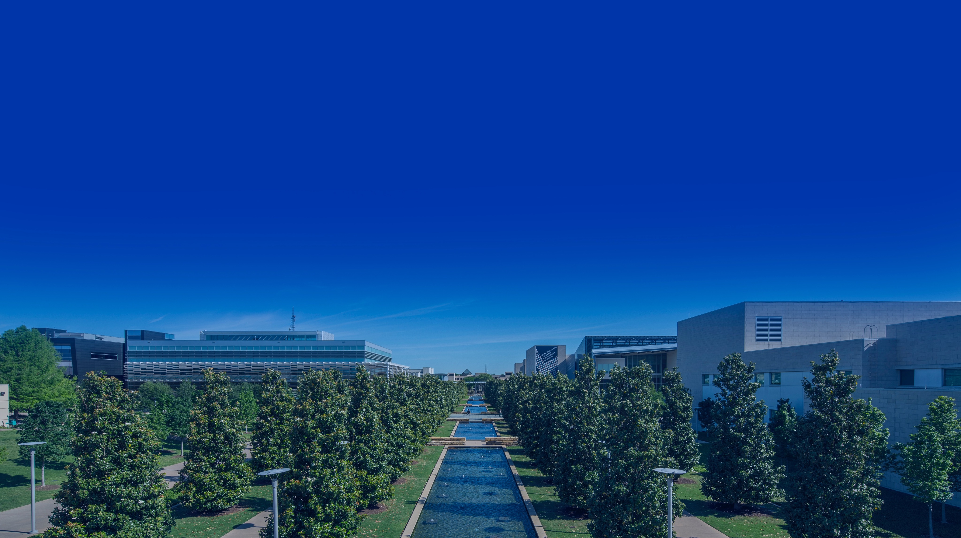
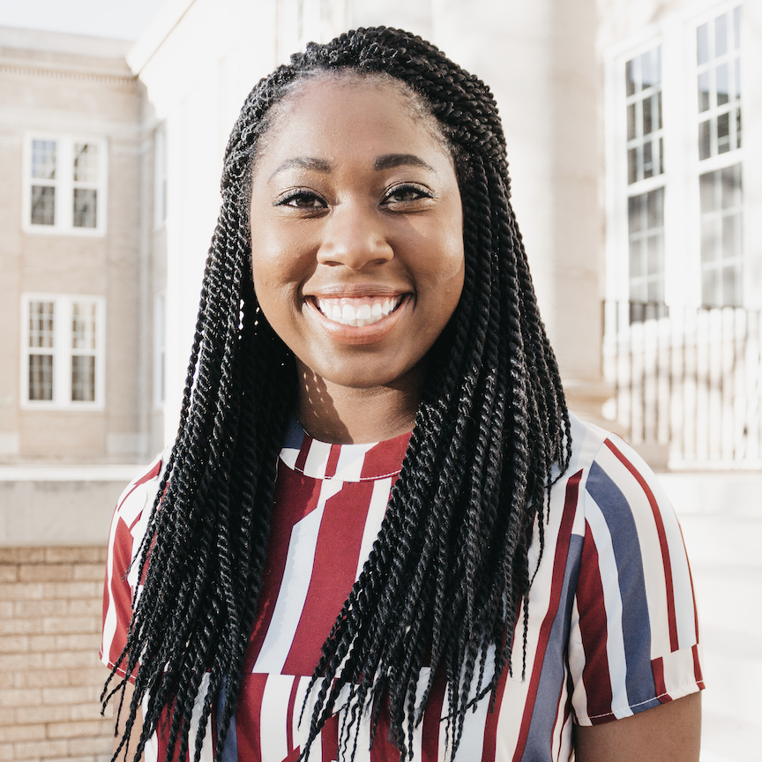
ORIENTATION 2021
Welcome
New Comets
Notes:
Slide 1:
Hello Comets and welcome to UTD! My name is Kaitlynd and I’m with the Student Success Center.

Slide 2
Student Success
Student
Success
The Campus
Experience
UT Dallas at
a Glance
Notes:
I’m about to walk you through some important information that, should you take advantage of, will change your life…. Or at least your time here at UTD.

Slide 3
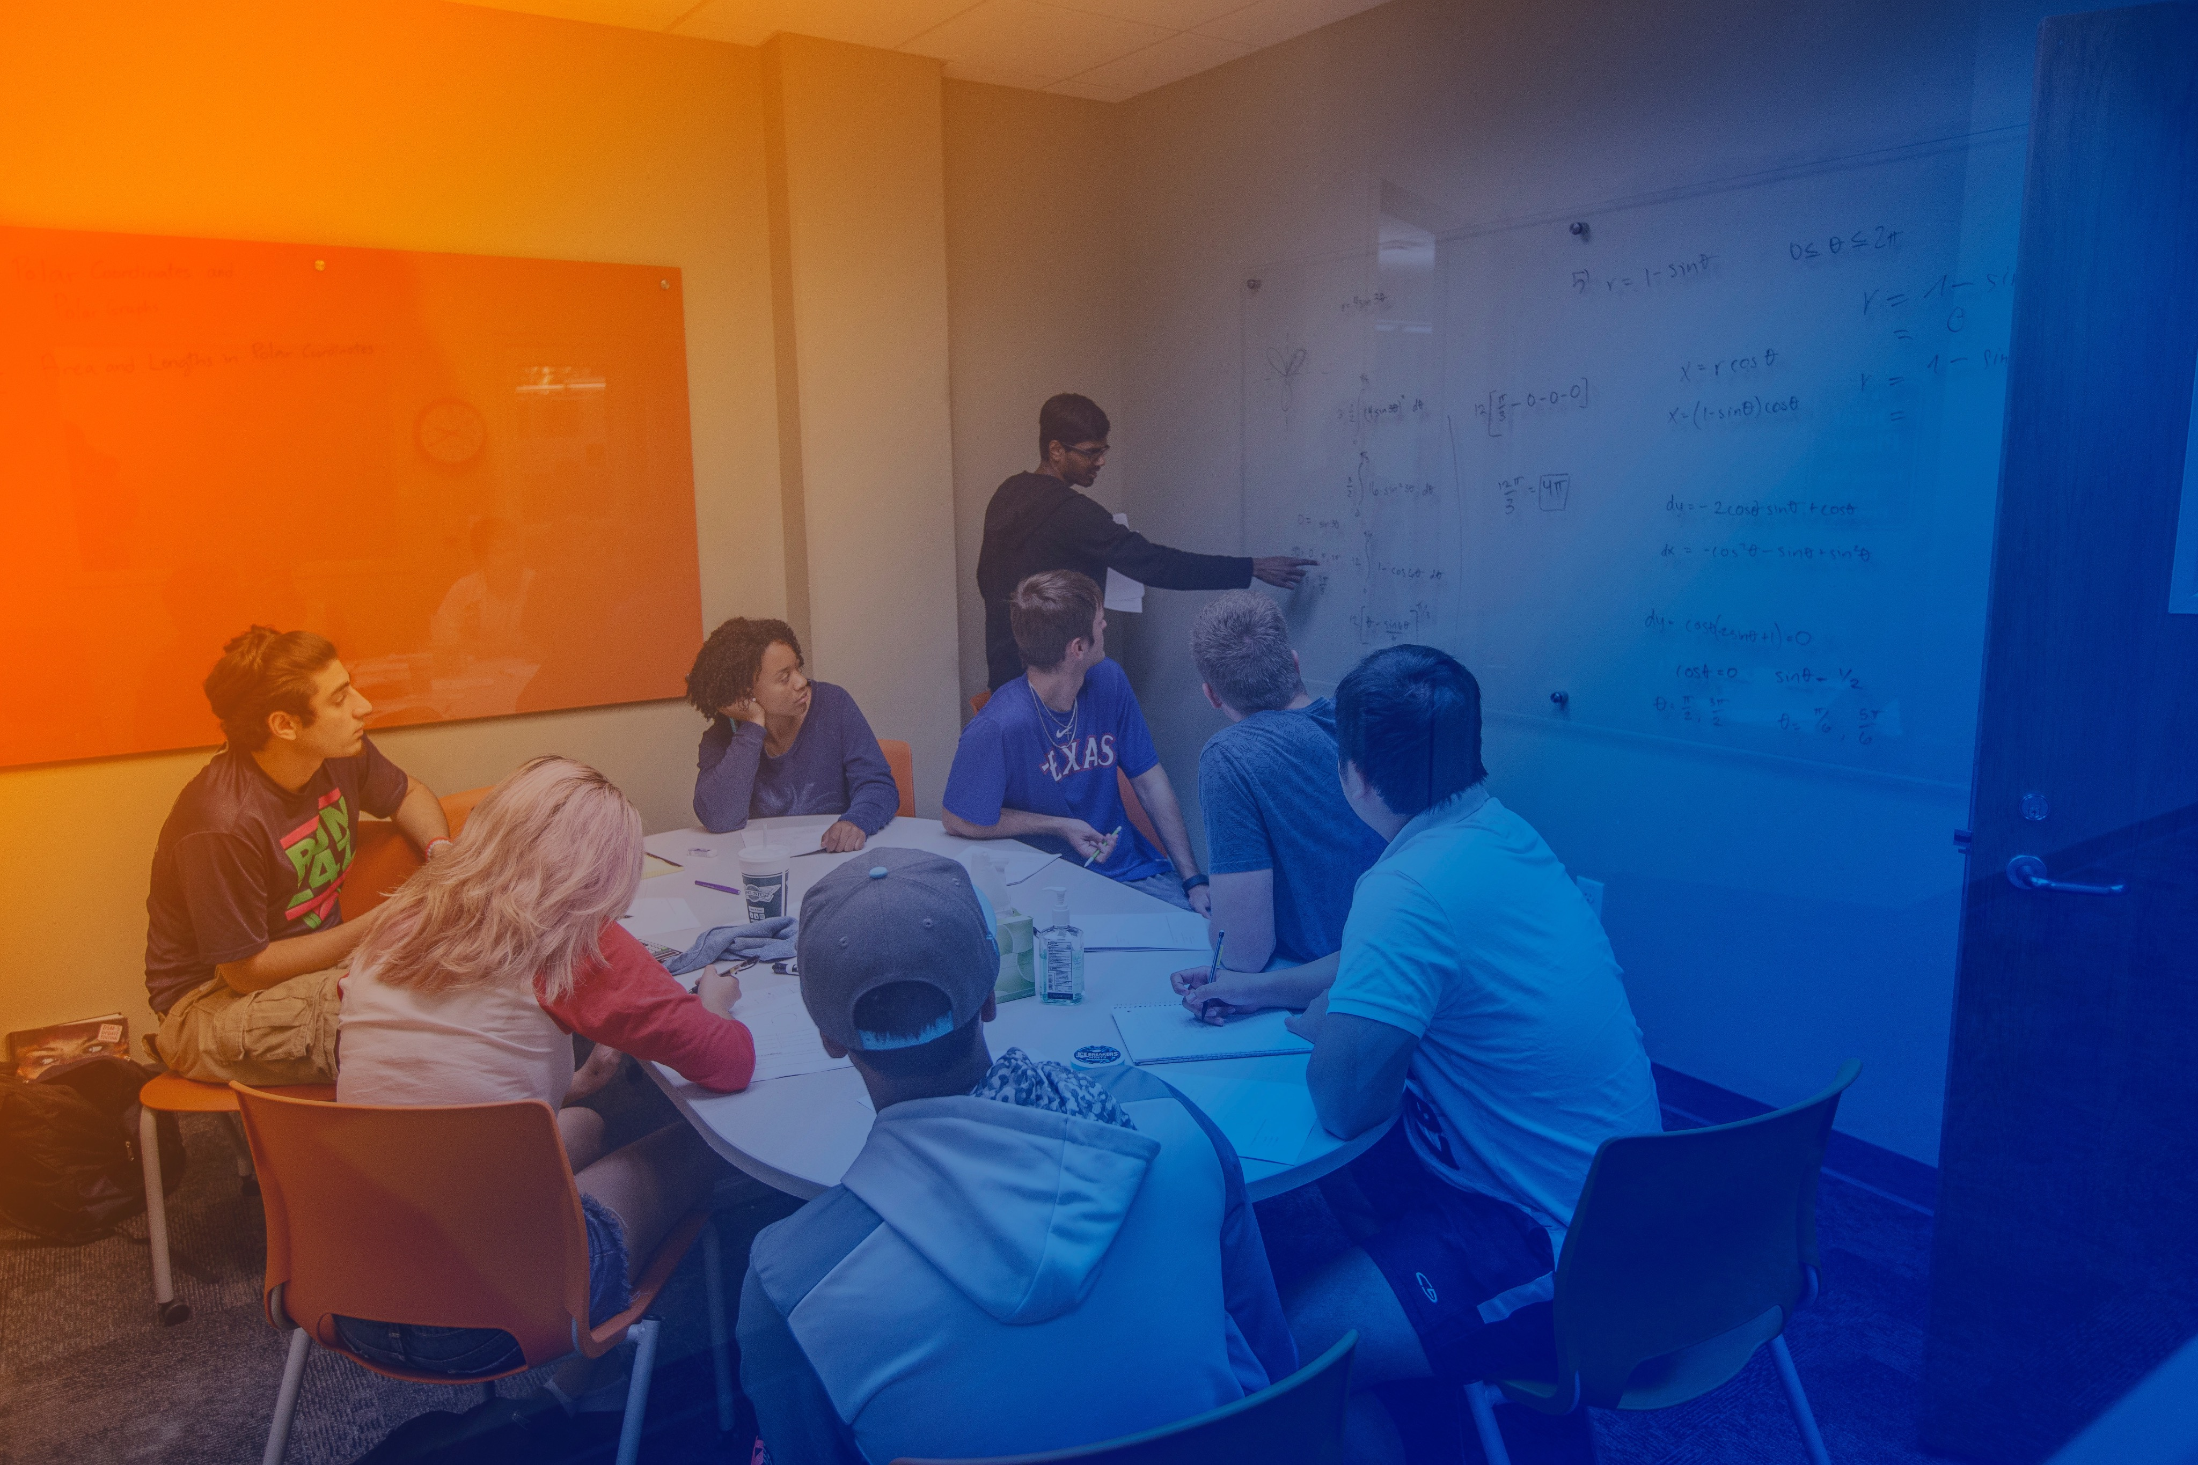
McDermott Library floors 1 & 3.
Employs more than 200 Peer Leaders who have scored an A- or higher in supported courses.
Proactive vs. reactive.
Students helping students.
Services are offered to all undergraduate students.
Included in tuition and fees.
Drop-in or make an appointment.
Website updated each semester.
Notes:
The Student Success Center, commonly referred to as the “SSC”, provides you with all the necessary tools and resources to achieve academic success at UT Dallas. Our team is equipped and ready to support you! Whether you need help with a paper, feedback on a speech or presentation, tutoring services, or other forms of academic support across a wide variety of subject areas. We are here to help you meet your academic goals.
If you’re trying to find us, we’re located on the 1st and 3rd floor of the McDermott Library. The SSC has a team of over 200 students who serve as peer leaders ready to assist you the moment you walk through our doors. All hired peer leaders have received an A- or higher in the courses they support. We are open to support all undergraduate students with services that are completely free. We try to operate with a proactive approach when it comes to student success and academic support. That means we encourage that you don’t wait until you need help with a specific subject or problem, but use our services early and regularly. Doing so helps you develop a deeper understanding of what you’re learning. The fact that our leaders in the SSC are students just like you, creates an environment that many Comets and the rest of the UTD Community love. You can come to our center knowing that you will be helped by someone who more than likely has been in your shoes!
I hope now you’re wondering, “How can I take advantage of this wonderful, free, student centered service, UTD is offering?” because I’m happy to tell you that getting the support you need couldn’t be easier! You can drop-in or make an appointment. Either method you choose, you’ll be glad you did. Our website is updated every semester so that you know all of the courses we are currently supporting.

Slide 4
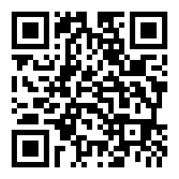
Peer Tutoring
tutoring@utdallas.edu
Drop-in tutoring for many 1000/2000/3000 level math, chemistry, physics, and engineering courses
No registration required
Weekly reviews and exam reviews for some courses
One-on-one and group appointments available
YouTube channel with recorded reviews and other content/informational videos
Notes:
One of the services we offer out of the SSC is called, Peer Tutoring which doesn’t require advance registration. Peer tutoring supports many of the 1000/2000 level math, science, physics, and engineering courses. During our hours of operation, you can drop-in or make an appointment. The cool thing about our Peer Tutoring space is that it’s a big open-lab environment. This type of set up allows for collaboration amongst peers. But don’t worry, you can also request 1:1 appointments as well! In addition to drop-in or appointment-based tutoring, Peer tutoring holds weekly reviews and exam reviews for select courses. If you can’t make it or like the advantages of reviewing on-demand, we’ve got you covered. Head on over to our YouTube channel where you can find recorded reviews and other content and informational videos.

Slide 5
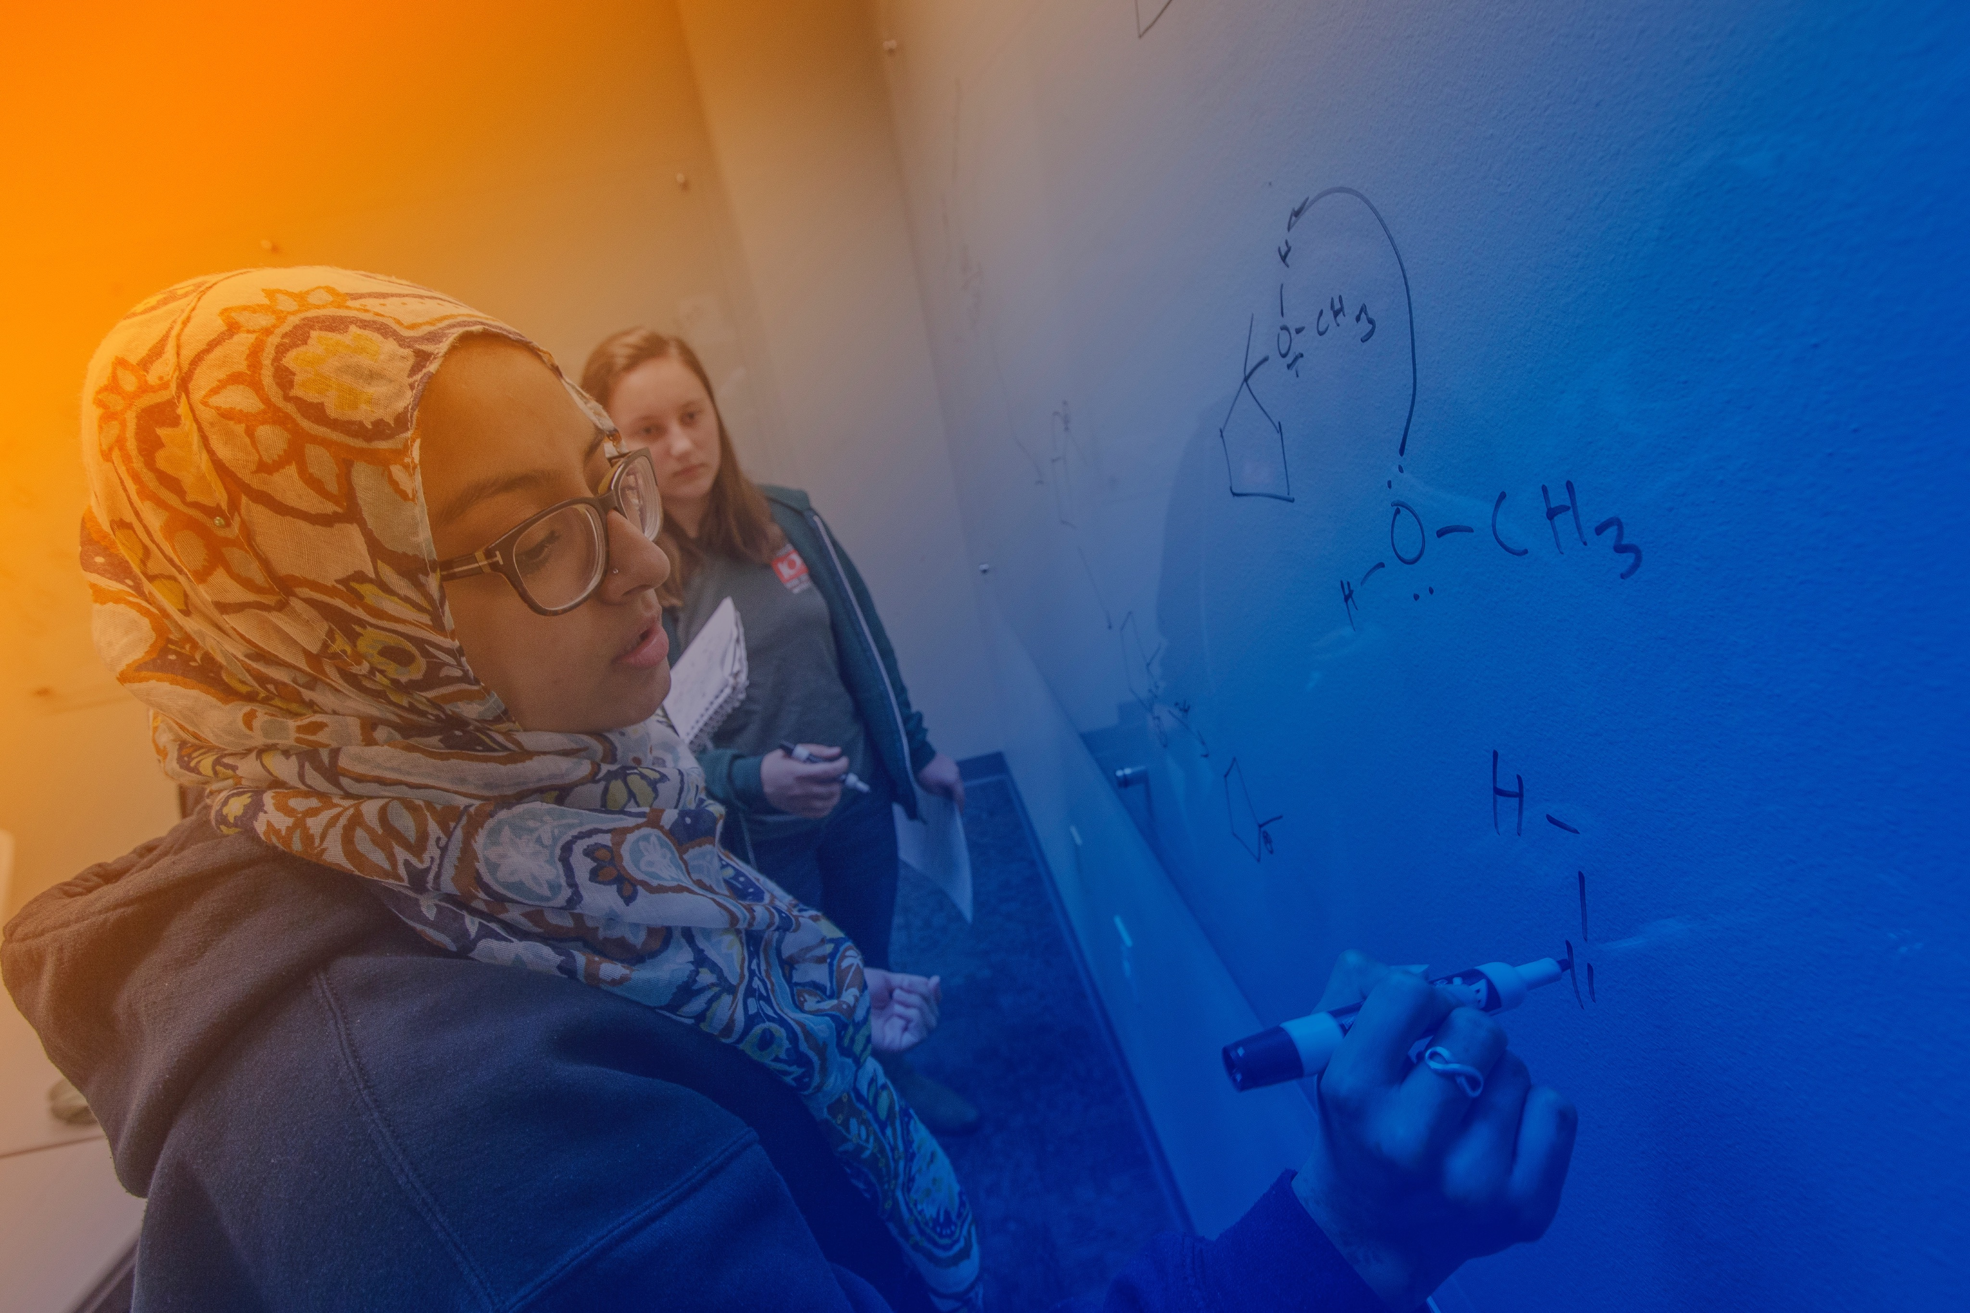
Peer-Led Team Learning (PLTL)
pltl@utdallas.edu
80-minute group sessions once a week
Supports science and math courses
Student-to-Peer Leader ratio: 8:1
Pre-register on the SSC website
Registration begins the first week of classes
Notes:
Another one of the programs within the SSC is Peer Led Team Learning, also known as, PLTL. PLTL meets 80 minutes once a week as a group comprised of 1 PLTL Leader and 8 students. PLTL supports both science and math courses. When you join a PLTL group, it’s a semester long commitment and you’re expected to be at every session each week during the semester. With PLTL there’s pre-registration on the SSC website and that begins the first week of classes. The registration process is a lottery system because of how popular this service is.

Slide 6
Supplemental Instruction (SI)
si@utdallas.edu
20+ courses supported
Two sessions per week
No registration required
Sessions based on class content
Notes:
The next program we offer is Supplemental Instruction. SI is offered in over 20 courses at UTD. SI is a group study session based on content covered in the course that day. SI is offered twice a week for each class supported. No registration is required other than being enrolled in the supported course. The cool thing about SI is that the leader actually sits in lecture and then designs the group study sessions based off of what was covered in the most recent lecture.
So let’s recap what we’ve covered before.

Slide 7
What’s The Difference?
 | Supplemental Instruction | Peer-Led Team Learning | Peer Tutoring Math and Science
Registration | X |  | X
Weekly Time Commitment | 50-75 minutes | 80 minutes | Unlimited (during staffed hours)
Structured and Supportive Learning Environment
Notes:
SI, PLTL, and Peer tutoring. What’s the difference? PLTL is the only one that requires registration. SI sessions are 75 minutes long and twice a week, PLTL sessions are 80 minutes, and Peer Tutoring is unlimited during staffed hours. All three of these programs create structured and supportive learning environments for students.

Slide 8
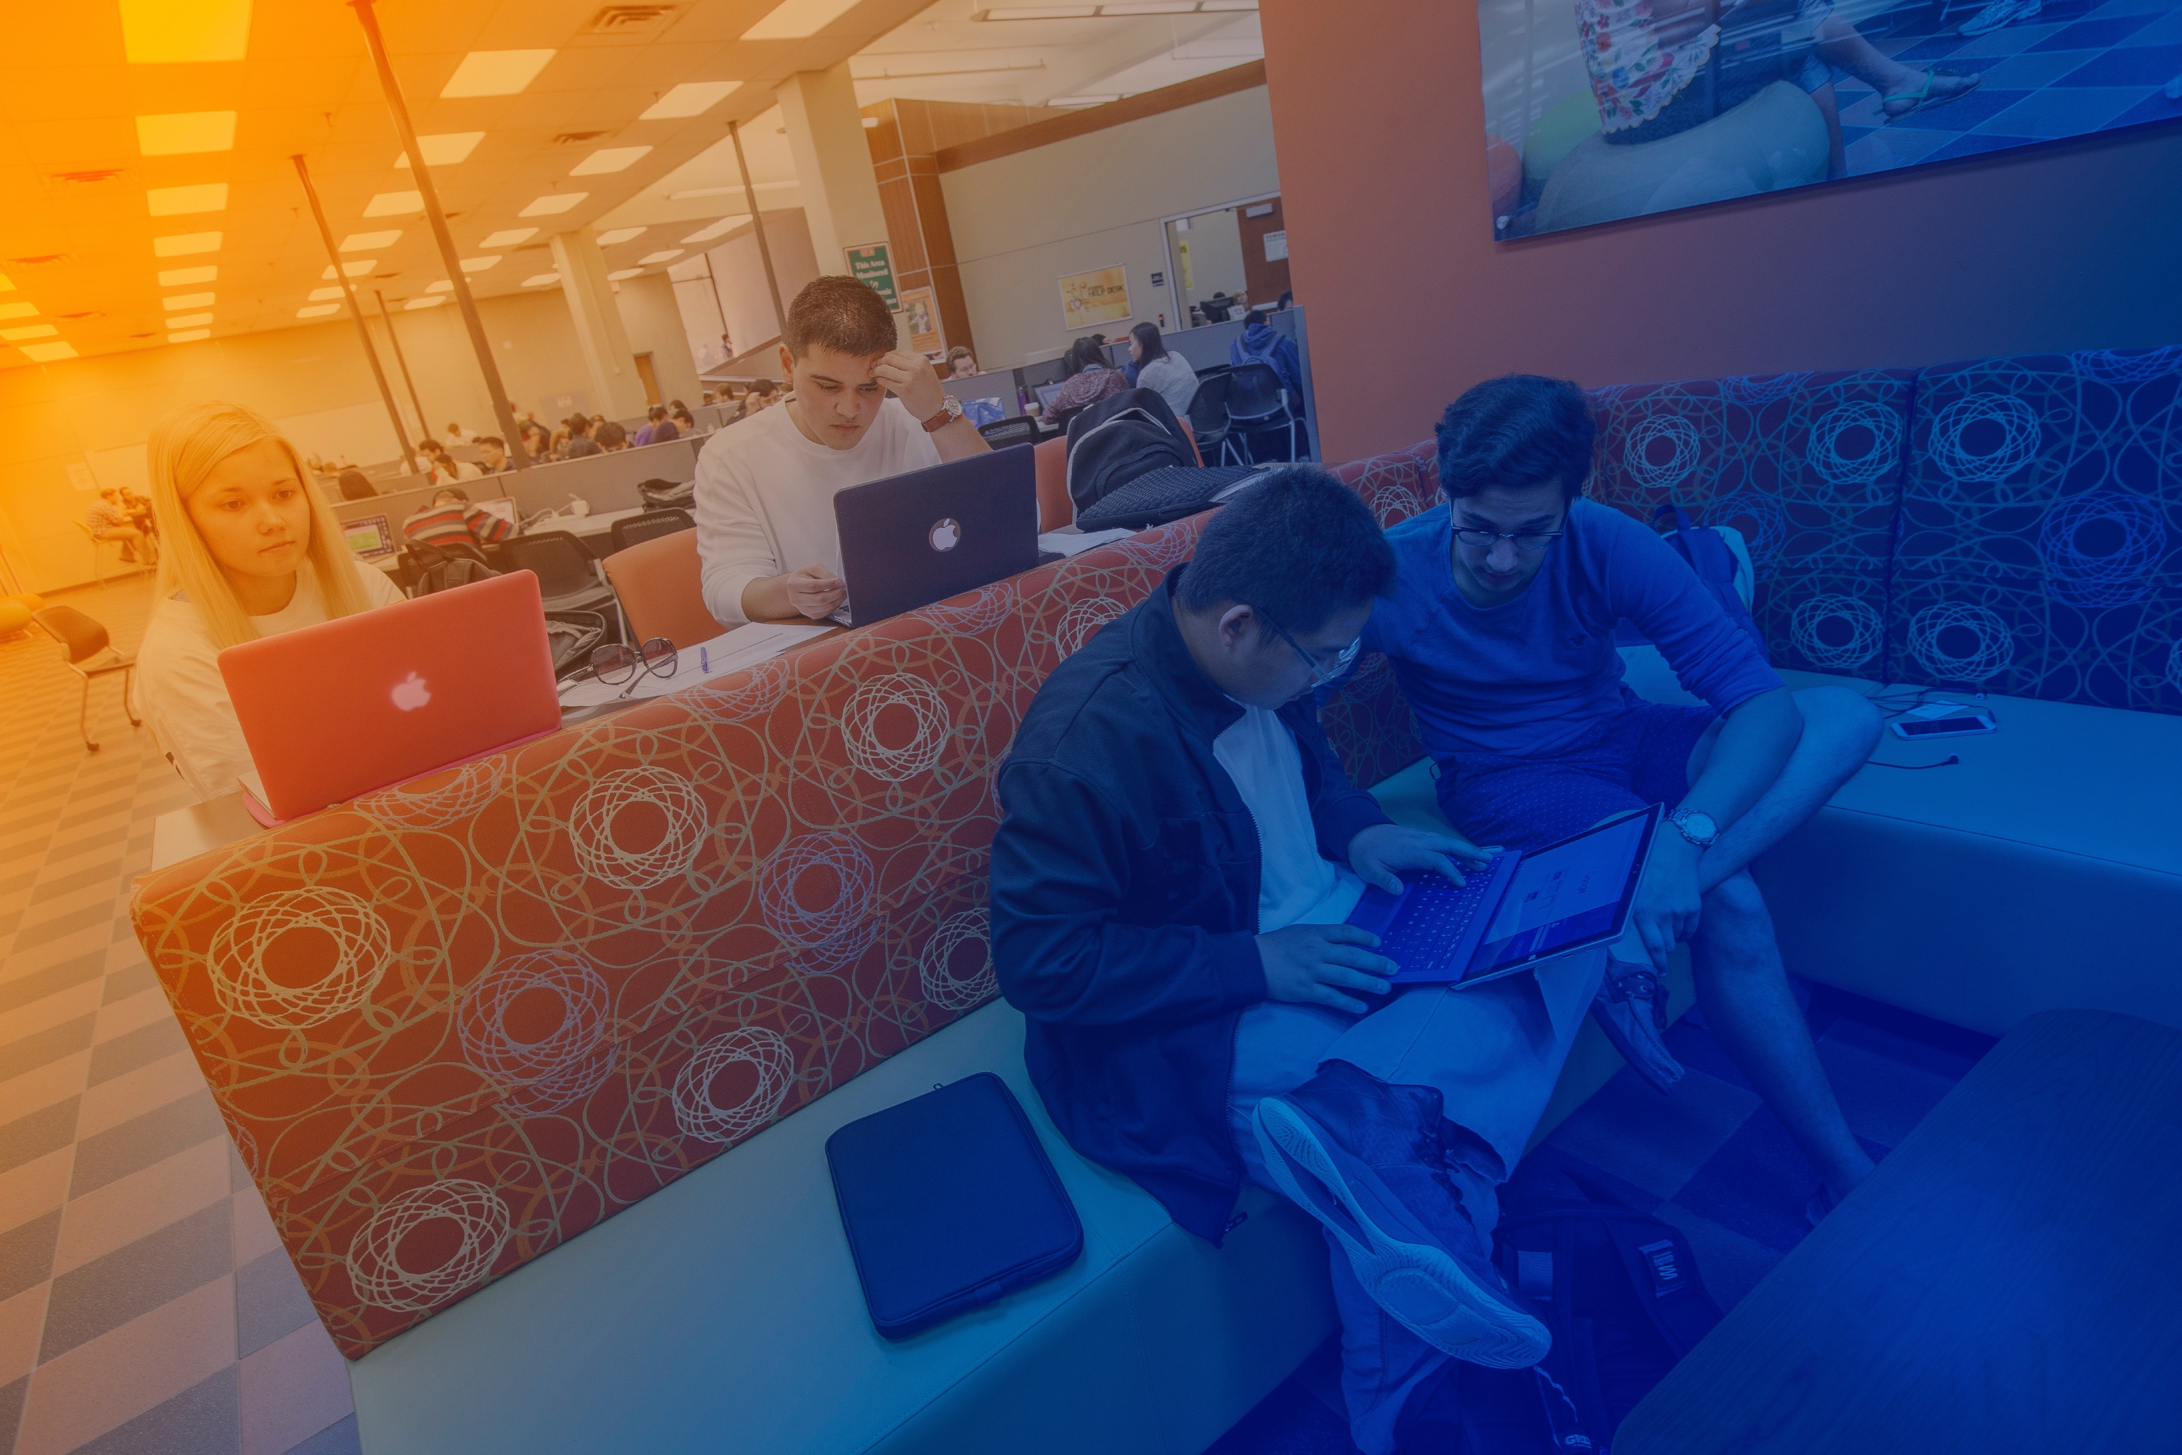
Academic Success Coaching
successcoaching@utdallas.edu
Assists with:
Time management
Prioritizing tasks
Effective study strategies
Note taking
Goal setting and motivation
Managing test anxiety
Workshops and 1:1 appointments available
Notes:
Here at UTD we recognize that college can be intimidating and very different from high school. That’s why we provide students with Academic Success Coaching. This service can help you learn how to navigate the college environment through workshops and 1:1 appointments. Our coaches work with you to develop time management skills, the ability to prioritize tasks, how to take effective notes, and even how to manage test anxiety.

Slide 9
CommLab
commlab@utdallas.edu
Feedback/resources for oral/group presentations
Individual and group appointments available
Supports COMM 1311/1315 and any course with a public speaking component
Notes:
Does the thought of giving presentations make you a little nervous? Stop by the SSC and take advantage of our Commlab! The Commlab is a really cool space where leaders can help you with any speech or presentation for any class while you’re here at UTD. They can even help if you’re working on a group speech and need to figure out where to stand and how to transition between speakers. The CommLab’s set up mimics the set up of a classroom. Which provides a more realistic experience than practicing in your bedroom. The Commlab supports COMM 1311 and any course with a public speaking component. There are individual and group appointments and we’ll give you feedback and resources on any individual or group presentations.

Slide 10
Writing Center
writingcenter@utdallas.edu
Build skills in:
Organizing and clarifying thoughts
Drafting and revising
Writing styles
Citing (MLA, APA, Chicago)
Personal statements
1:1 appointments, drop-in hours, and workshops available
Notes:
The writing center is another service offered out of the Student Success Center. The leaders can help with any stage of the writing process; from understanding the assignment, to brainstorming, grammar help, and even checking for plagiarism. The tutors come from a variety of majors and can help with any writing assignment from any class as well as personal statements for grad school. There are 1:1 appoints, drop in hours, and workshops available.

Slide 11
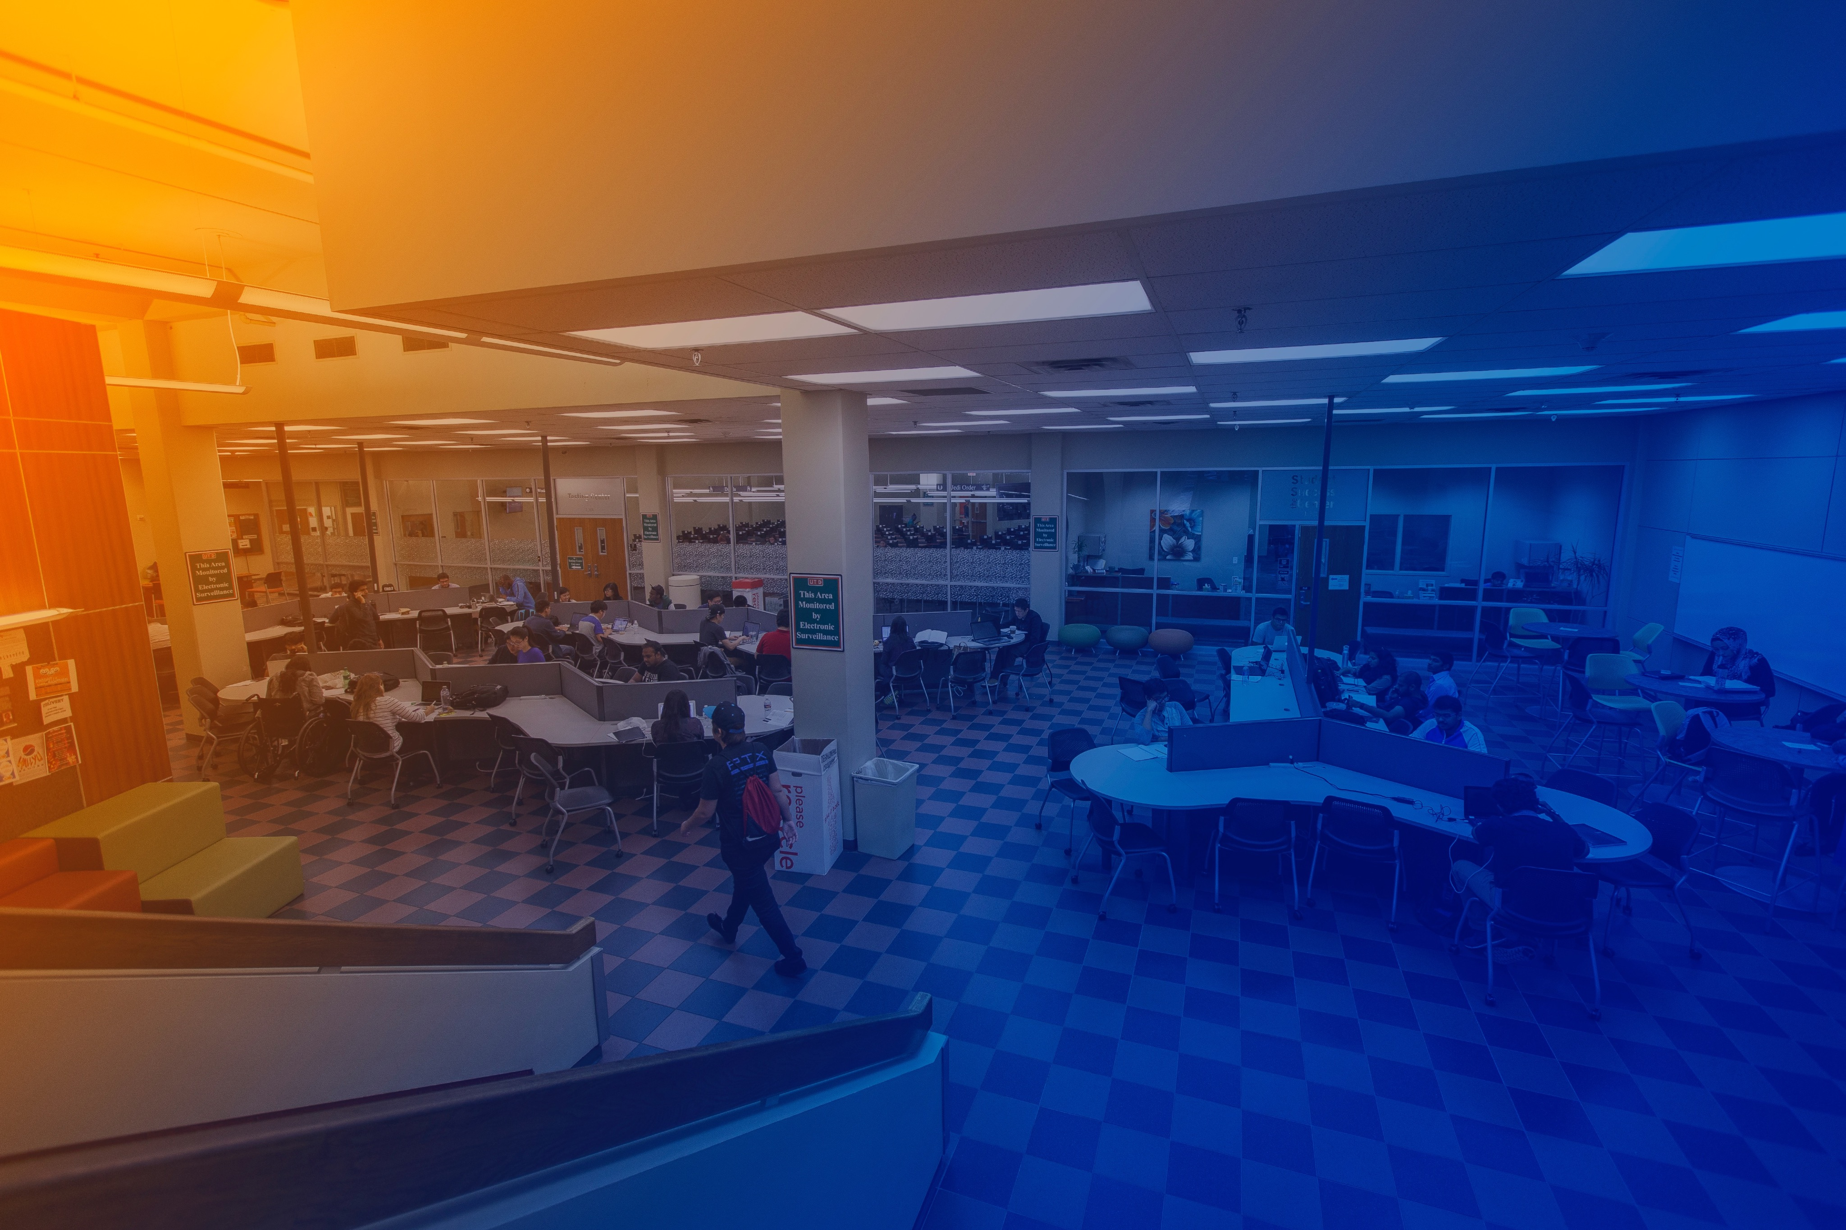
Success Workshops
https://studentsuccess.utdallas.edu/workshops-camps/
General Chemistry
For students entering CHEM 1311
Calculus
For students entering Calculus I
Organic Chemistry
For students entering CHEM 2323
Physics
For students entering Physics I
College 101
For all students
Registration opens July 1
Notes:
The last thing we offer are Summer Success Camps. To help with the transition to college we hold a variety of camps designed with your success in mind. Ranging from Chemistry and Math to our College 101 curriculum. These topics include
Professional Communication
Money Management and Budgeting
Adulting 101

Slide 12
Visit our website:
utdallas.edu/studentsuccess
Notes:
Please visit utdallas.edu/studentsuccess. Feel free to reach out to us if you have questions or want any more information about our programs. We look forward to seeing you in the fall

